Slide 1
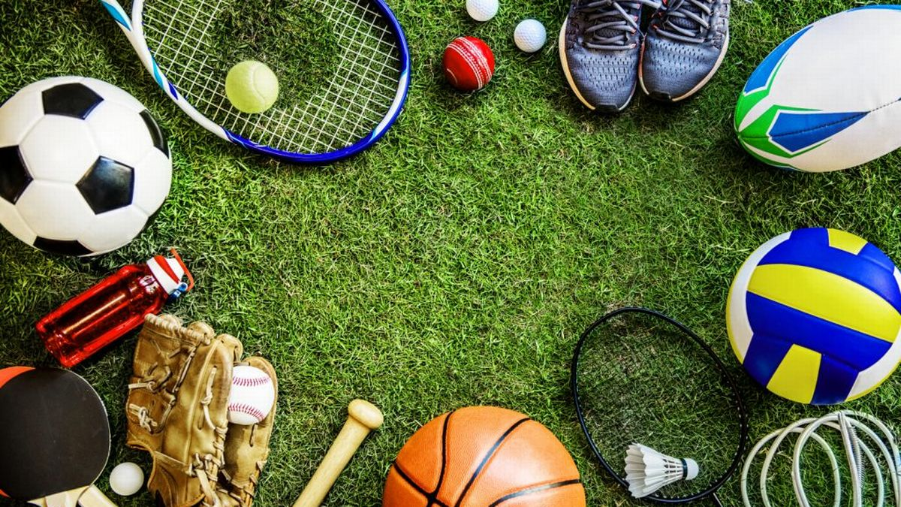
PRELIMINARY VALIDATION OF THE SPORT FAN MOTIVATION SCALE
- Daniel L. Wann (1995)

Slide 2
How people are involved with sports?
As a spectator – One who is observse sport events,
OR
As a Fan- One who is enthusiastic about a particular sport or athlete
What are the motivations for sports fans?
Relatively little impirical work has examined these persons
(Thomas, 1986; Zillmann, Bryant, and Sapolsky,1989)
- Only 4% of the research published in sport psychology and sociology journals focused on fans. ( Wann and Hamlet, 1995)

Slide 3
Possible Motivations of Sports Fans
8 motivation from different sport fan theories:
1. Eustrees - Branscombe and Wann,1994; Elias and Dunning,1970 Sloan,1989;
Wenner and Gantz,1989
2. Self esteem benefits - Branscombe and Wann,1994; Sloan, 1989; Gantz, 1981
3. Escape from everyday life - McPherson, 1975; Sloan,1989; Smith ,1988
4. Entertainment - Sloan, 1989; Gantz, 1981; Zillmann et al., 1989
5. Economic Factors - Chorbajian, 1978; Guttmann, 1986
6. Aesthetic Value – Duncan 1983; Guttmann,1986; Sloan, 1989; Smith, 1988
7. Affiliation needs - Branscombe and Wann,1994; Guttmann,1986; Sloan, 1989 ; McPherson, 1975;
Smith ,1988; Wenner and Gantz, 1989
8. Family Needs - Guttmann,1986; Gantz, 1981

Slide 4
Objective
Valid and reliable measure of sport fan motivation has been unavailable to researchers
This study was an attempt to develop such a measure, the Sport Fan Motivation Scale(SFMS)
Study 1 examines the factor structures of the SFMS and the relationship between the SFMS and various demographic and sports involvement measures
Study 2 reviews the the test-retest reliability of the SFMS and the relationships between the SFMS and the enjoyment of watching various sports

Slide 5
Method (Study 1)
Subjects: 272 (100 male, 172 female, mean age 22.9 years). 166 university students,
remaining were associated with recreational softball league. White 90%,
black 7% and asian 3%.
Procedure: Group of 10-25. Six paged questionaire which takes approximately 30 minutes each.
Materials:
Section 1: Demographic items like age, gender, race, education, household income,
level of study, number and order of siblings etc.
Section 1: Scale for how much they consider themselves and their parents or friends to be sports fan –
1= “Not at all a sports fan”, to
8= “Very much a sports fan”

Slide 6
Method (Study 1)
Section 2: 38 items designed to assess one of the different motivations for involvement as a sports fan. Likert scale format
1= “This is not all descriptive of me”, to
8= “This is very descriptive of me”
Results (Study 1)
Explanatory factor analysis: Item representing austress and self esteem subscales loaded on the same factor. Others loaded on separate scales.
Items with highest loading with their factor have been included.
Final scale: 23 items reflecting eight dimensions of fan motivation.

Slide 7
Results (Study 1)
Confirmatory factor analysis: Conducted using EQS structural equation modeling program, was an attempt to fit the data to the hypothesized eight factor model.
Comparing the confirmatory factor analysis among single factor, seven factor and eight factor model shows that, the data fit the eight-factor model extremely well.
Chronbach`s reliability alpha for entire scale: 0.90
1. Eustrees – 0.89
2. Self esteem benefits – 0.78
3. Escape from everyday life – 0.85
4. Entertainment – 0.85
5. Economic Factors – 0.84
6. Aesthetic Value – 0.81
7. Affiliation needs – 0.72
8. Family Needs – 0.63

Slide 8
Results (Study 1)
Correlation analysis:
Correlation between the SFMS and variables such as level of identification and degree of self reported fanship have been used to establish the criterion validity of the instrument.
Correlation with demographic variables have been used to show if the scale is sensitive to a specific population.
Result Interpretations in the journal:
Total SFMS is positively and significantly correlated with each measure of involvement , showing the validity of the scale.
The correlations between subscales and the involvement items also supports the validity of instrument. Only the economic subscale fails to be significant.
For demographic items, no significant correlation found for total SFMS measure. So SFMS is not dependent or unequally sensitive to any specific population.

Slide 9
Method (Study 2)
Subjects: 144 (79 male, 65 female, mean age 23.0 years undergraduate psychology students. White 92%, black 6% and asian 2%.
Procedure: Group of 10-25. Six paged questionaire which takes approximately 15 minutes each.
Materials:
Section 1: Demographic items identical to study 1.
Section 2: 38 items developed in study 1
1= “This is not all descriptive of me”, to
8= “This is very descriptive of me”
Section 3: Rate the extent they like 13 different sports.
1= “I definitely do not like to watch this sport”, to
8= “I definitely do not like to watch this sport”

Slide 10
Results (Study 2)
Scale analysis: Eight factor model is an exceptional fit with the data.
Chronbach`s reliability alpha for entire scale: 0.90
On the total SFMS and the eustress, self esteem, escape, entertainment, and aesthetic, men scored significantly higher than women, whereas women exhibited higher levels of motivation on the family subscale.
Demographic: Two significant items, i.e., Age and income comes out significantly correlated with total SFMS.
Enjoyment: total SFMS is positively correlated with each sport, significantly for 10 of the 13 sports.
Test-retest reliability: Total SFMS and subscales are high level consistent.

Slide 11
Results (Study 2)
Result Interpretations in the journal:
Result of study 2 confirms that SFMS is an eight factor model.
Study 2 demonstrates strong reliability of the instrument, as the test-retest correlation are highly significant.

Slide 12
Validation procedures in terms of the evidence categories in the Standards for Educational and Psychological Testing
In this journal following validation evidence has been used:
Criterion-related validity (Concurrent): Indicates the extent to which the instrument’s scores correlate with an external criterion i.e. motivation facets.
Convergent validity: Possible predictor has been selected from different measures that measure possible SFMS.

Slide 13
Evaluation of the validity of the test score interpretation and uses
Standard 1.1 : The test developer should set forth clearly how test scores are intended to be interpreted and consequently used. The population(s) for which a test is intended should be delimited clearly, and the construct or constructs that the test is intended to assess should be described clearly.
Comment: The test has been done with the sample with average age of 29 years, more than 90% participants are white and majority of them are students. So, it will not be valid to generalize the result.
Standard 1.2: A rationale should be presented for each intended interpretation of test scores for a given use, together with a summary of the evidence and theory bearing on the intended interpretation.
Comment: The uses of test scale has not been explained clearly. For example, how exactly this scale can be used in research investigating fan violence has not been mentioned.
Standard 1.3 If validity for some common or likely interpretation for a given use has not been evaluated, or if such an interpretation is inconsistent with available evidence, that fact should be made clear and potential users should be strongly cautioned about making unsupported interpretations.
Comment: It is yet to research the extent to which scores on the SFMS vary by sport types. If it varies by sports types, it will not be appropriate to generalize it by SPORTS.

Slide 14
Evaluation of the validity of the test score interpretation and uses
Some interpretations not supported by any evidence in the study:
1. Swimming tends to be a family activity.
2. Because of the success of basketball team, family get it as a family gathering.
3. Fans who like wrestling gets a self esteem boost from the good-guy.

